Slide 1
Correlation Analysis of Weight by Sex
Findings and Recommendations

Slide 2
Introduction
Correlation measures the strength and direction of the relationship between two variables.
The purpose of this analysis is to investigate whether there is a difference in weight between males and females.
The null hypothesis (H0): There is no significant difference in weight between males and females.
The alternative hypothesis (H1): There is a significant difference in weight between males and females.

Slide 3
Data Description
The data was from a national survey monitoring health behavior among youth and young adults that is the Youth Risk Behavior Survey (YRBSS).
The total number of observations in the dataset is 21,755, that is 10970 females and 10694 males. This includes 21,664 valid observations and 91 missing observations.
The weights range from approximately 0 to 200 kilograms. The Mean (Average) Weight was 67.63 kilograms with a Standard Deviation of 16.691 kilograms and the median was 63.50 kilograms.

Slide 4
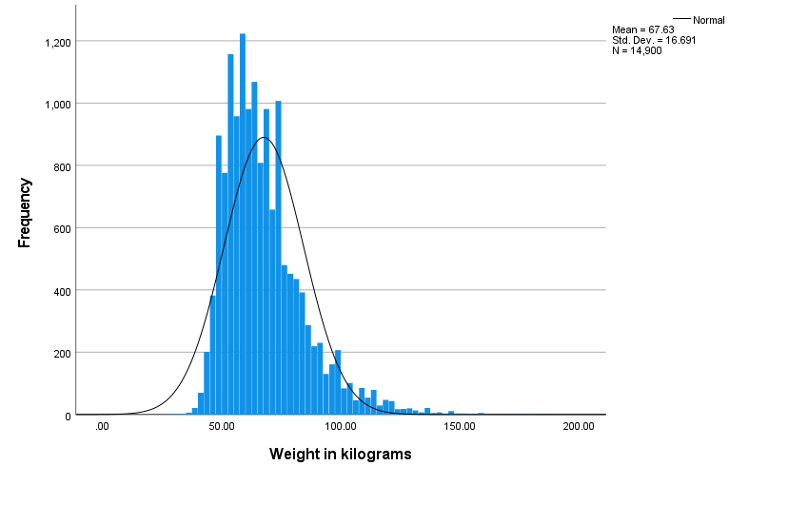
Distribution of weight
The figure below shows the histogram distribution of weight in kilograms.

Slide 5
The weights range from around 0 to 200 kilograms, with most observation falls within the range of around 50 to 60 Kilograms.
The distribution appears to be slightly right-skewed, indicating weight is non-normally distributed. This means there is a longer tail on the right side, indicating that there are more observations with weights greater than the mode.
The Kurtosis seems to be leptokurtic. This is indicated by the sharp peak compared to a normal distribution curve, suggesting that more of the variance is due outliers in the data.

Slide 6
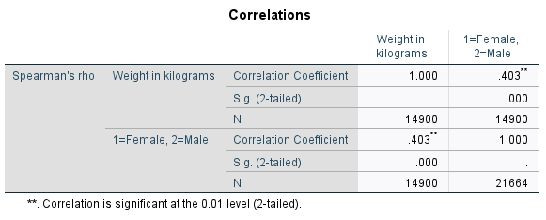
Spearman's rank correlation
The table below shows the Spearman’s correlation coefficients between weight in kilograms and sex

Slide 7
Findings
The correlation coefficient between weight and sex is 0.403, indicating a moderate positive correlation. This means that as the value for sex changes from female to male, the weight tends to increase as well.
The significance level (Sig. 2-tailed) for this correlation is 0.000, which is highly significant at the 0.01 level. This means that the observed correlation is statistically significant.

Slide 8
Conclusion
The analysis aimed to investigate whether there is a significant relationship in weight between males and females. The correlation between sex and weight, we found a moderate positive correlation coefficient of 0.403. This indicates that males tend to weigh more than females.
The correlation was statistically significant at the 0.01 level, with a significance value of 0.000, hence we reject the null hypothesis and conclude that there is a significant difference in weight between males and females.

